Slide 1

Smart Gambling
Ambreen Simon, Sebastien Vezina, Stephen Chen,
Wazarat Hussain, & Val De Franco
Notes:
We created a decentralized application called Smart Gambling involving a player rolling a virtual die and betting on the outcome.

Slide 2

Background
Growing interest in adopting blockchain for online gambling:
Privacy protection
Data security
Ease of virtual transactions
Circumvent local regulations and restrictions
Notes:
Blockchain technologies are being used for many noble purposes. Not wanting to be different, our group has focused on the noble pursuit of gambling. Blockchain is well suited for gambling: it offers privacy protection and data security all with the ease of virtual transactions. In some cases, a player can circumvent local laws/regulations to gamble, as is their fundamental right!

Slide 3
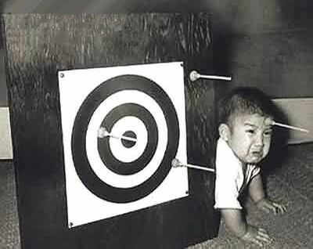
Aim
To create a simple online game utilizing:
Smart contract
Crypto-currency such as Ether for betting
GUI (frontend)
Via GUI, a player will bet their wei and roll a virtual die.
Winners receive 5x the bet + refund of the original bet.
Notes:
Our project creates a smart contract using a GUI for an interface, and a smart contract as the backend. In our game, the player picks a number from 1 to 6, and rolls a six-sided die. If the die comes up with his/her # then they win.

Slide 4
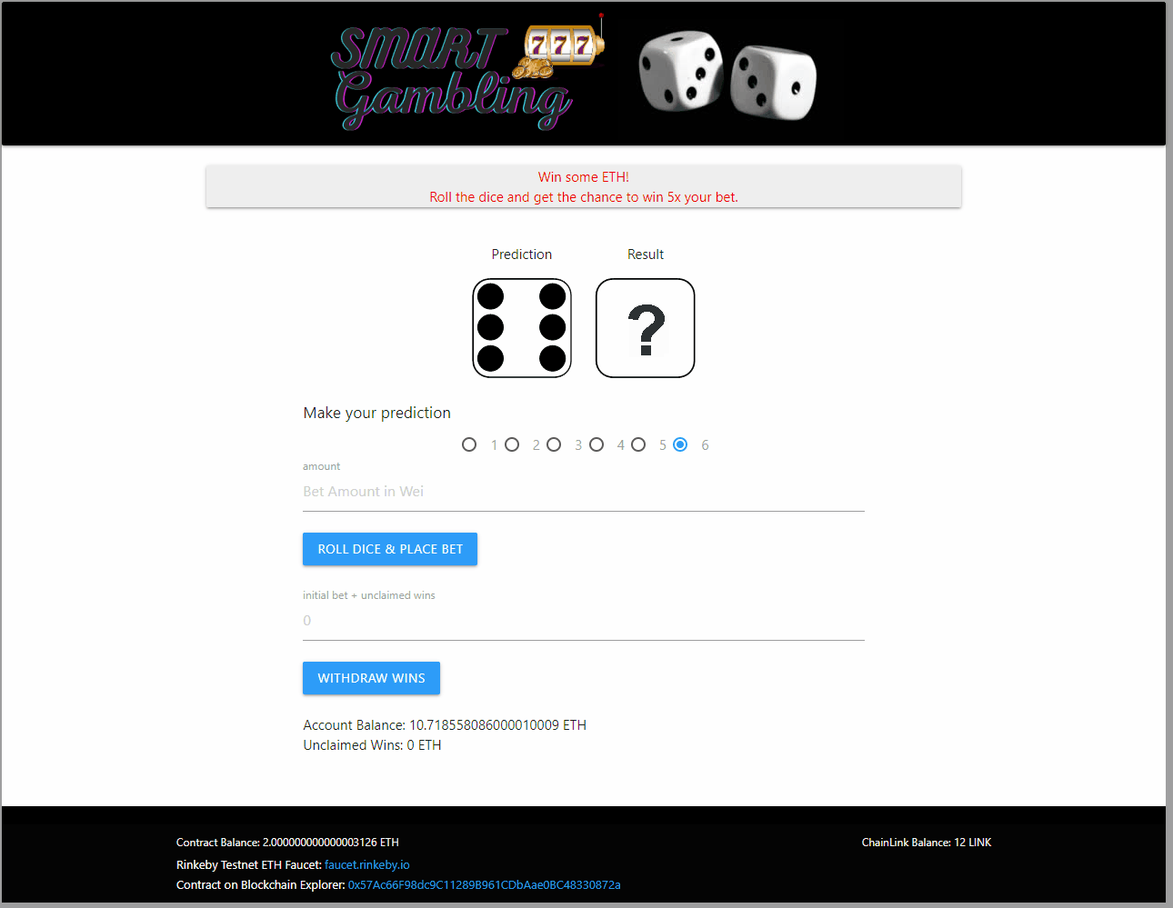
DApp
Notes:
This is a quick view of what our dapp looks like and towards the end, Sebastien will show a full demo.

Slide 5
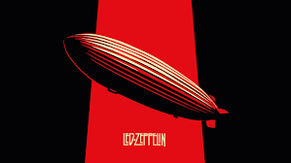
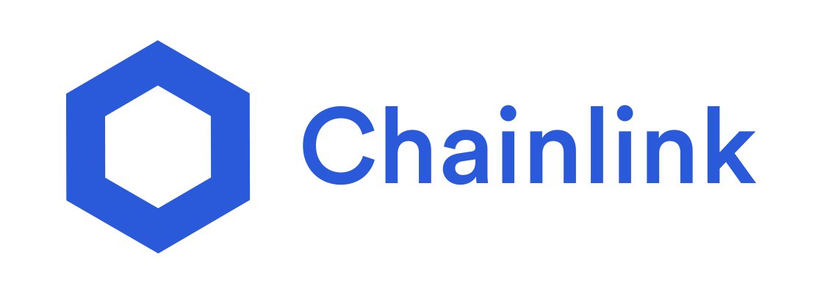


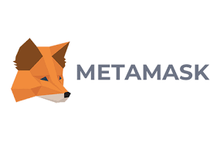
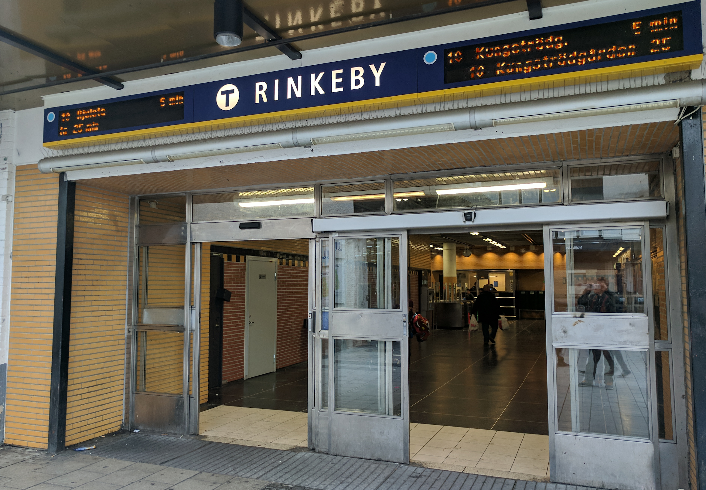
Resources
Solidity, Remix
OpenZeppelin, SafeMath
ChainLink
Web3.js - Ethereum JavaScript API
MetaMask, Rinkeby Ethereum Testnet
HTML, JavaScript
Notes:
You can see all the resources that our project uses here. Of particular note, we use Solidity to construct our smart contract in Remix. Our smart contract include OpenZeppelin and SafeMath. We also use an external oracle network called Chainlink and we connect it to our smart contract using Web3.js in conjunction with Ethereum JavaScript API. We are using MetaMask and Rinkeby Ethereum Testnet. Finally our frontend is done using HTML and Javascript.

Slide 6
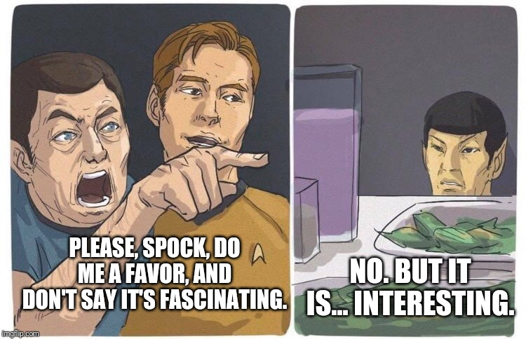
Points of Fascination
Challenge:
Random Numbers
Solution:
Oracle = Chainlink + Verifiable Random Function
Notes:
Random number generation is a point of challenge in blockchain programming. Val will discuss this in more detail. For our contract, our solution is to use the ChainLink Oracle in concert with Verifiable Random Function (VRF).

Slide 7

What is an Oracle?
Sends data from the outside world to the blockchain
Smart contracts aren’t designed to take care of everything
Just like normal businesses, sometimes rely on suppliers or vendors, in this case, an Oracle such as Chainlink.
Notes:
In today’s modern world, businesses tend towards specialization and accordingly do not complete all tasks involved in product/service creation. They typically use supplier or vendors for inputs. Smart contracts are no different. They often need objective & credible information from outside the contract: an Oracle. Oracles typically provide financial information or information on world events,and in our case, a random number.
I will hand this over to Val.

Slide 8
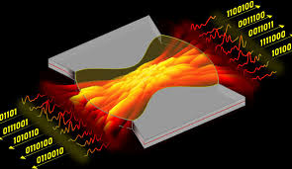
Random Numbers
Random ≠ Random
Algorithms use a seed such as time or mouse movements.
Can be solved.
Usually random enough for most applications.

Slide 9
Random Numbers
Two other issues:
Potential conflict of interest with miners.
Decentralized vs. centralized - single point of failure.

Slide 10
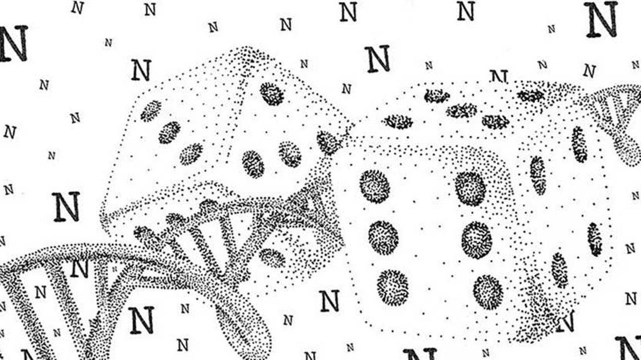
Random Numbers
Options:
Use Blockhash or Block Timestamp.
Use Centralized API or Oracle.
Chainlink Decentralized Oracle - Verifiable Random Function (VRF).

Slide 11
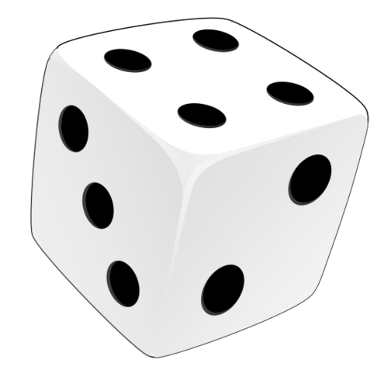
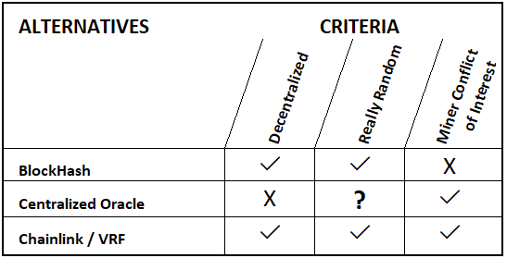
Random Numbers

Slide 12

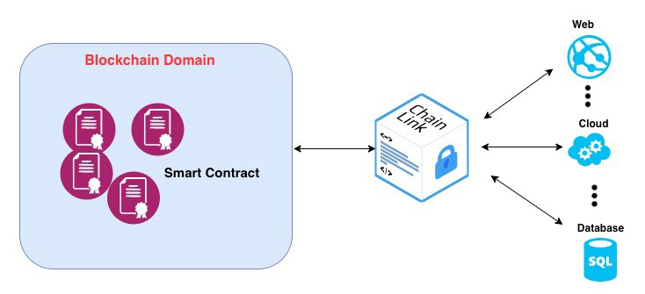

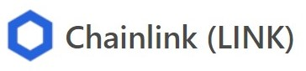
Random Numbers
Solution: Chainlink/VRF.
As a network, multiple nodes operating.
Removes single point of failure.
VRF is usable for our project.
Specifically, we use Chainlink.

Slide 13
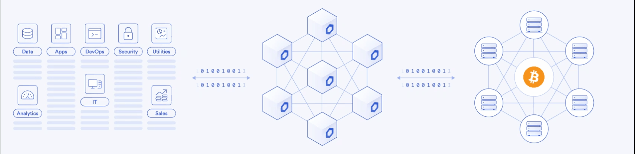
Smart contracts
VRF

Slide 14
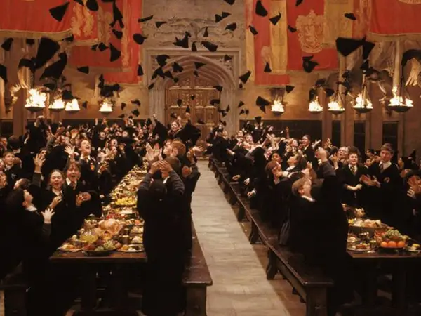
Events
Bridge between contract & front-end.
We are using 3 events: BetPlacedEvent, BetResultEvent, withdrawWinsEvent.
Front-end monitors for these events to refresh GUI.

Slide 15
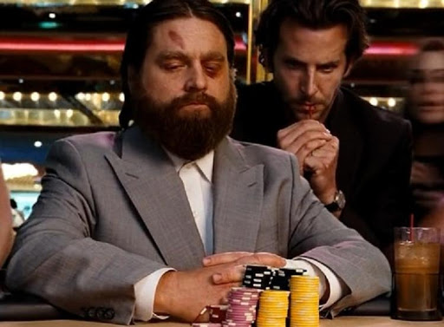
Players
Supports multiple players: use player address and timestamp as unique identifier.
Code must account for:
deposits
amount owing to players
unresolved bets in queue
withdrawals

Slide 16
Demo

Slide 17

Future Directions
Backend:
Automatic refill of Link tokens on UniSwap or other platform.
Determine real world value of Link in order to determine minimum bets.
Create ERC20 tokens to incentivize and garner loyalty from players.
Frontend:
More/different games.
Implement interactive graphics.
Multi-language interface.
Provide log/history of player’s bets.

Slide 18

Questions?
?

